Slide 1
Cryptocurrency and Blockchain Forensics
Some Slides are adapted from Dan Boneh and Benedikt Bünz at Stanford University

Slide 2
What is a blockchain?
Abstract answer: a blockchain provides
coordination between many parties,
when there is no single trusted party
(Trusted party = blockchain technology)
if trusted party exists ⇒ no need for a blockchain
[financial systems: often no trusted party]
Notes:
but blockchains also used in other areas, like digital asset management, e.g., as in online games.

Slide 3
How blockchain works?
http://blockchain.mit.edu/how-blockchain-works
1. Hash
2. Block
3. Blockchain
4. Distributed Blockchain
5. Tokens
6. Coinbase
Notes:
The headers are included in the hash: block#, nonce, and DATA (and there could be other headers added into the information to be hashed, such as previous mined block).
You need all previously mined (validated) blocks in order to build the next valid block mined (or to be mined).
Blocks can be reversed and remined; so that is why for large transactions you should wait for about 6 blocks to be validated before doing/committing to a transaction.
Distributed blockchain: each node has their own copy of the chain; validation can be cross referenced by multiple machines to check if someone is trying to use a re-mined blockchain.
So crypto is a consensus problem → the true chain is basically the one most voted on (confirmed) by the most nodes.
If you control 51% of the total mining power allocated to a crypto, you can control the mining of block chain because your nodes will always be voted as the most validated chain and you will always mine successfully (since you control 51% of the power/nodes, then you can make it so your nodes are in sync and when a block is mined they will all be quick to validate it).
This is why people have mining pools; even if you as an individual mine successfully, there is a very small chance it is the validated chain; so it is best to join a pool with more total computing power.

Slide 4
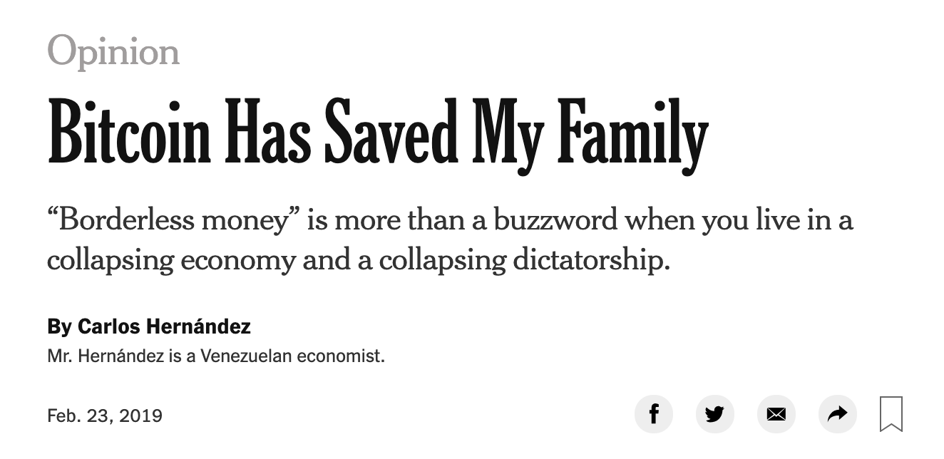

What is all the excitement about?
(1) Basic application: a digital currency (stored value)
Current largest: Bitcoin (2009), Ethereum (2015)
Global: accessible to anyone with an Internet connection

Slide 5
What is all the excitement about?
(2) Beyond stored value: decentralized applications (DAPPs)
DeFi: financial instruments managed by public programs
examples: stablecoins, lending, exchanges, ….
Asset management (NFTs): art, game assets, domain names.
Decentralized organizations (DAOs): (decentralized governance)
DAOs for investment, for donations, for collecting art, etc.
(3) New programming model: writing decentralized programs
Notes:
SMART CONTRACTS = source code published on block chains for DeFi, NFTs, and DAOs.
New Programming model = programs written for SMART contracts.

Slide 6
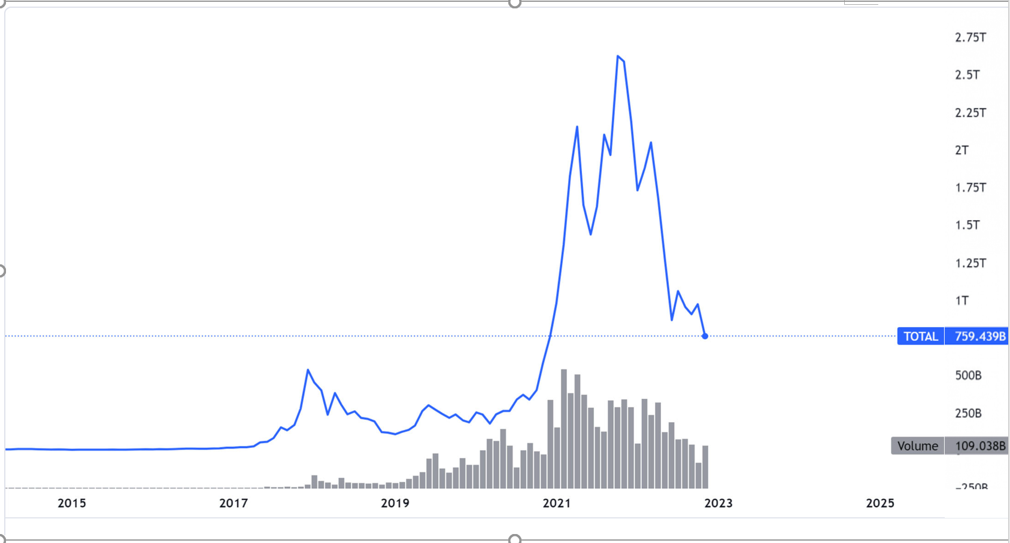
Total Crypto Market Capitalization and Volume, $
Nov 22, 2022

Slide 7
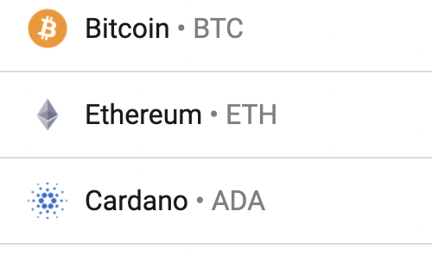
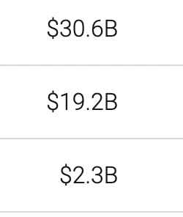
Transaction volume
24h volume Sep. 2021

Slide 8
What is a blockchain?
user facing tools (cloud servers)
applications (DAPPs, smart contracts)
compute layer (blockchain computer)
consensus layer
Notes:
Consensus (synchronization) problem is most important and challenging aspect of blockchain technology.
Consensus layer = all nodes have to agree on the most current blockchain.

Slide 9
Consensus layer (informal)
achieved by replication
A public append-only data structure:
Persistence: once added, data can never be removed*
Safety: all honest participants have the same data**
Liveness: honest participants can add new transactions
Open(?): anyone can add data (no authentication) (permissionless)
consensus layer
Notes:
[Pass, Seeman, Shelat, 2016]
Blockchain data needs to be public: private blockchains are not part of this course.
Blockchain = distributed ledger (distributed, decentralized database).
Using hashing, all transaction added to the blockchain cannot be modified or reversed (persistence).
Need to convince 51% of the nodes to use a different fork in order to “reverse” a transaction = but since the database is decentralized, this is very difficult.
For consensus: if developers want to change the software and make some changes, then they can create a fork, but enough nodes have to accept the update to their code which result in a different hash than users using the old software to do the hashes; both forks can exist, actually (called hard fork), where users of old software can keep their software the same for hashing with mining and transaction, and the nodes that accept the update will mine and commit transactions according to the new software. But notice it is all still decentralized.

Slide 10
How are blocks added to chain?
blockchain
signed
I am the leader
2 ETH
sk_{A}
verify
block
verify
block
sk_{B}
sk_{C}
Notes:
Leader = proof of stake; needed to start a new FORK; if too many people trying to start a new block then the fork will fork out into many forks and the blockchain will diverge. Whoever is selected as leader for proof of stake will get some percentage reward (for doing the computation and leading the new fork) in the currency created by the new fork
Leader broadcast new computed blocks for the new fork so that all other nodes will verify the blocks and thus also update their personal databases to match the leader and thus eventually when enough nodes update their database they are essentially accepting the update/change/fork.

Slide 11
How are blocks added to chain?
blockchain
…
2 ETH
I am the leader
sk_{A}
sk_{B}
2 ETH
sk_{C}
Notes:
Like a cloud service paid for by inflation.

Slide 12
Why is consensus a hard problem?
Tx1, Tx2, Tx3, Tx4
Tx1, Tx2, Tx3, Tx4
Tx1
Tx3
Tx2
Tx4
Tx1, Tx2, Tx3, Tx4
Tx1, Tx2, Tx3, Tx4

Slide 13

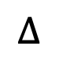
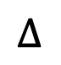
Why is consensus a hard problem?
Tx1, Tx2, Tx3, Tx4
Tx1, Tx2, Tx3, Tx4
Tx1
$$∆$$
Tx3
Problems:
Network delay
Network partition
Tx2
Tx4
$$∆$$
Tx1, Tx2, Tx3, Tx4
Tx1, Tx2, Tx3, Tx4
Notes:
In case of network partition: can stop accepting transactions (Paxos), or can accept transactions and resolve fork once partition heals (Bitcoin).
Network delay can be caused by nodes crashing; then a transaction may not be verified and that fork will lose out to other winners; this is why (for example) with bitcoin you need at least 6 nodes to verify your transaction to know that your transaction safely went through and was accepted as the main (winning) fork and thus was committed to the blockchain successfully.

Slide 14

Why is consensus a hard problem?
Tx1, Tx2, Tx4
Tx1
Problems:
crash
malice
Tx2
Tx4
Tx1, Tx2, Tx4
Tx1, Tx2, Tx4
Notes:
Goal: security when 51% of nodes are honest.

Slide 15
The blockchain computer
DAPP logic is encoded in a program that runs on blockchain
Rules are enforced by a public program (public source code)
⇒ transparency: no single trusted 3rd party
The DAPP program is executed by parties who create new blocks
⇒ public verifiability: everyone can verify state transitions
compute layer
consensus layer
Notes:
GAS FEE: every blockchain network has a limitation to number of transactions that can take place in a given time window; if too many nodes are trying to make transactions at the same time, then the network can become congested and transactions will be very slow to be verified and added to the chain; thus gas fees by miners can be given so they can use their computation power to add their transaction to the chain so that it will be verified it faster at a percentage fee for their work of adding the transaction to the block chain. Obviously if you have more computational power, then you can cause a change to be propagated on the network faster to all other nodes, and thus there is a higher probability that a given set threshold number of nodes will be able to verify your transaction faster (since they will have downloaded and committed the change to their blockchain database).

Slide 16
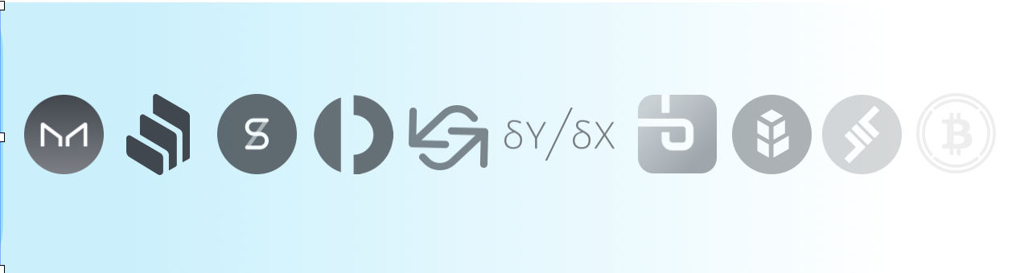
Decentralized applications (DAPPS)
Run on blockchain
computer
applications (DAPPs, smart contracts)
blockchain computer
consensus layer

Slide 17
Common DAPP architecture
Top layer: user facing servers
end user
blockchain computer
DAPP
DAPP
DAPP
on-chain state
consensus layer

Slide 18
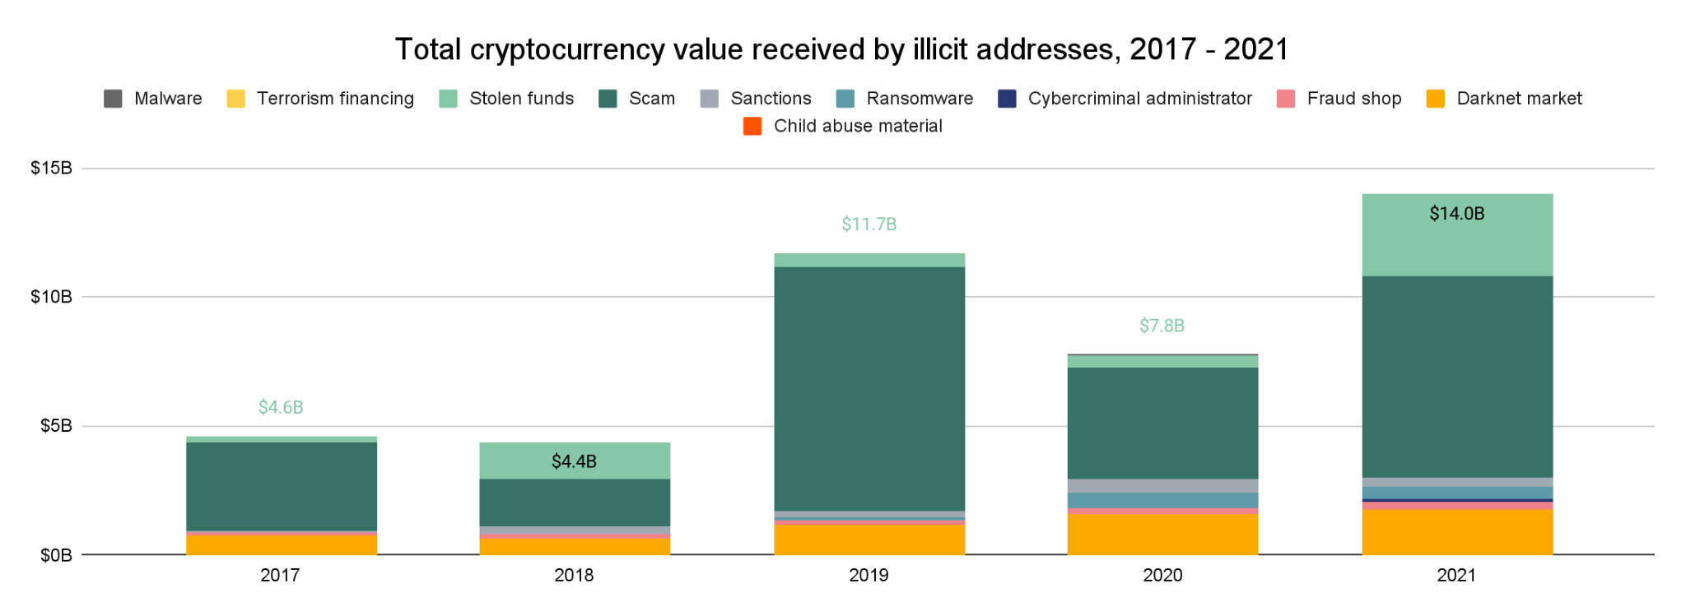
Cryptocurrency-based crime hit a new all-time high in 2021, with illicit addresses receiving $14 billion over the course of the year, up from $7.8 billion in 2020
$2.9 T
Trillion worth of cryptocurrency transactions in 2020

Slide 19
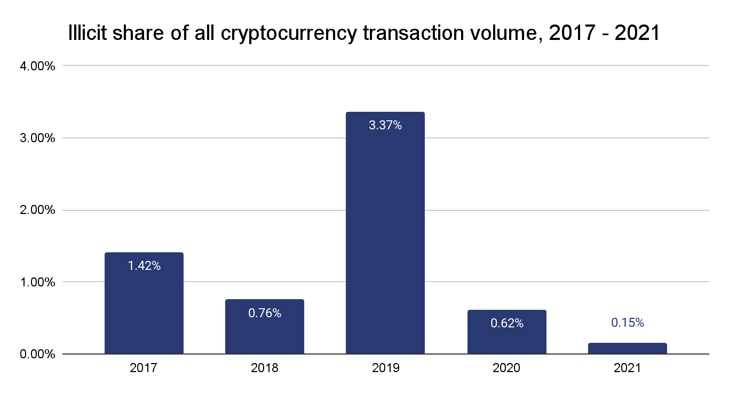
The share of overall activity associated with illicit wallets hit an all time low, with criminal volumes representing only 0.15% of all economic activity

Slide 20
Cryptocurrency-based Crime
Ransomware
High-risk jurisdictions & sanctions evasion
Money laundering
Scams
Hacks
Darknet markets and fraud shops (employs Tor/onion ring + cryptocurrency)
Notes:
For smart contract, database and the code to maintain the transaction is public; so it can make the contract open to hacking.
Usually criminals are risk takers, so the were the first to adopt crypto currency.
Some lacks of decentralization in crypto currency: miners who control too much of the mining power; centralized exchange points (wallet storage) for some crypto currency such as FTX; centralized developers (relatively few developers involved in crypto space).

Slide 21
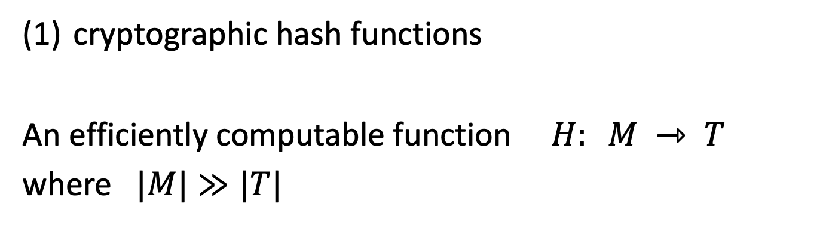
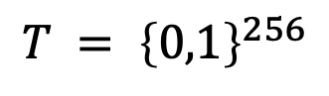
Cryptography Background
cryptographic hash functions
An efficiently computable function $H: M ⇾ T$
where $|M|≫|T|$
32 bytes
megabytes
hash value
$$T = {\left\{0,1\right\}}^{256}$$
Notes:
2 primary types: HASH → SHA 256

Slide 22
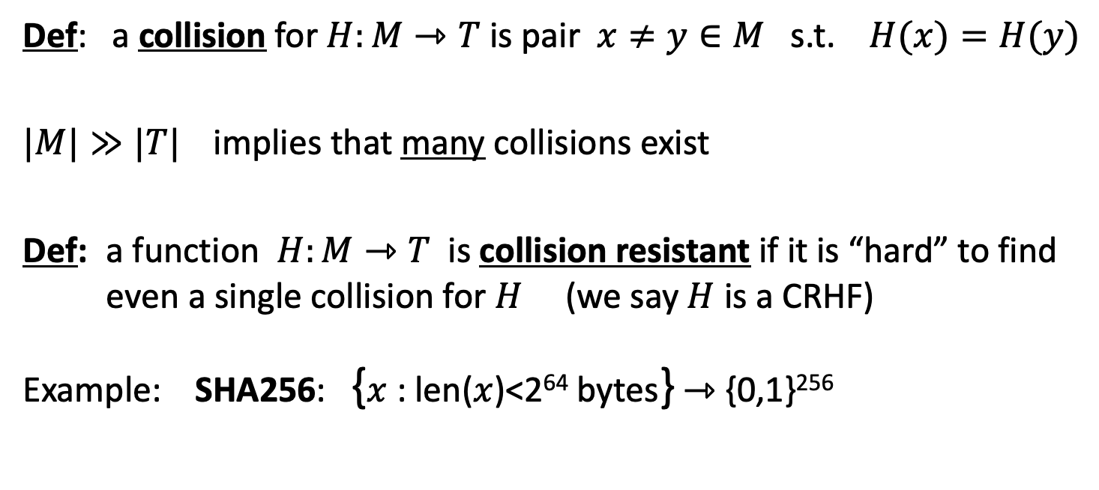
Collision resistance
Def: a collision for $H:M⇾T$ is pair $x≠y∈M$ s.t. $H(x)=H(y)$
$|M|≫|T|$implies that many collisions exist
Def: a function $H:M⇾T$ is collision resistant if it is “hard” to find even a single collision for $H$ (we say $H$ is a CRHF)
Example: SHA256: {$x$ : len($x$)<2⁶⁴ bytes} ⇾ {0,1}²⁵⁶

Slide 23
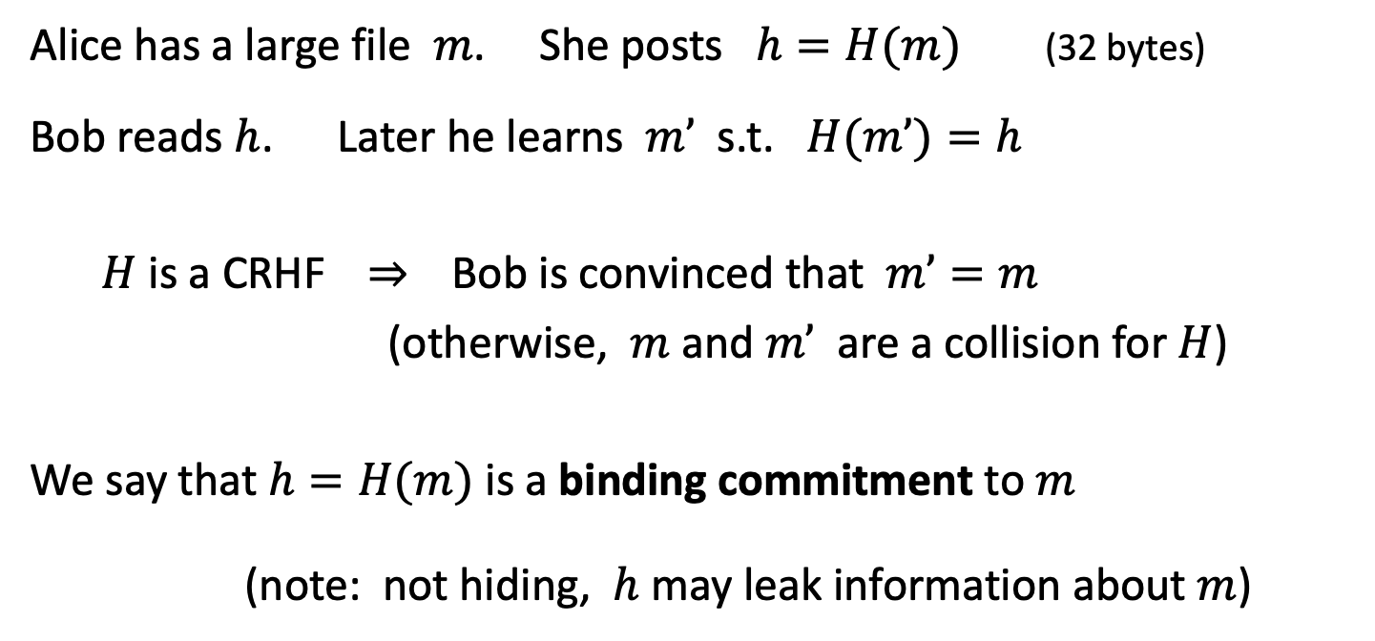
Application: committing to data on a blockchain
Alice has a large file $m$. She posts $h=H(m)$(32 bytes)
Bob reads $h$. Later he learns $m’$ s.t. $H(m’)=h$
$H$ is a CRHF ⇒ Bob is convinced that $m’=m$
(otherwise, $m$ and $m’$ are a collision for $H$)
We say that $h=H(m)$ is a binding commitment to $m$
(note: not hiding, $h$ may leak information about $m$)
Notes:
Alice posts hash h on the blockchain.

Slide 24
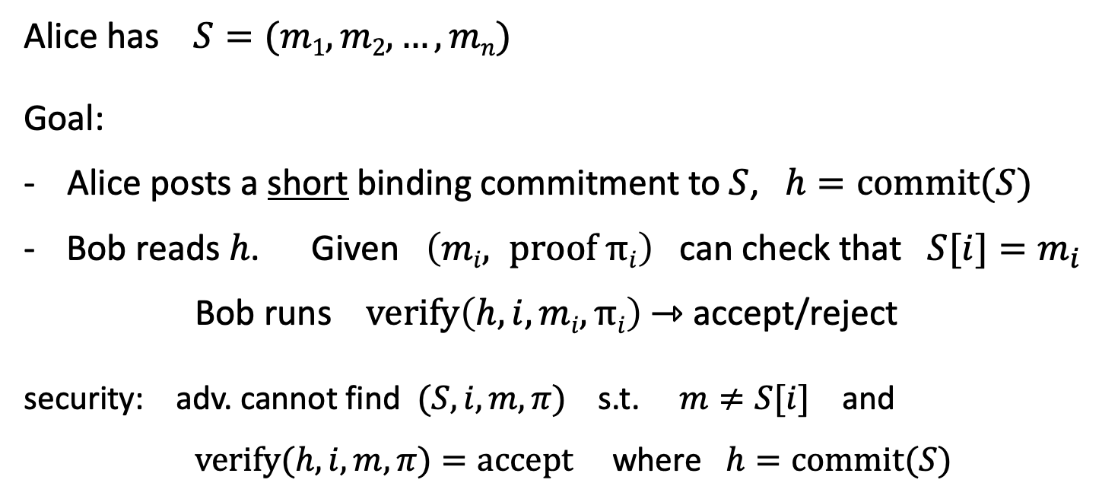
Committing to a list (of transactions)
32 bytes
Alice has $S=(m1,m2, …,mn)$
Goal:
- Alice posts a short binding commitment to $S$, $h=commit(S)$
Bob reads $h$. Given $\left(mi, proof πi\right)$ can check that $S[i]=m_{i}$
Bob runs $verify\left(h, i, mi, πi\right)$ ⇾ accept/reject
security: adv. cannot find $(S, i, m, π)$s.t. $m≠S[i]$ and $verify(h,i,m,π)=accept$where $h=commit(S)$

Slide 25
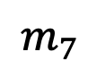
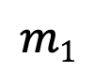
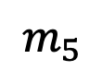

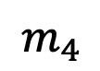
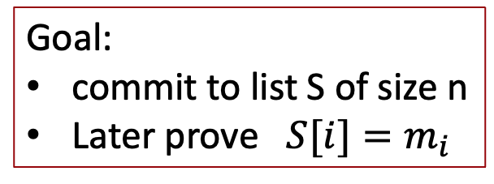
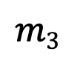
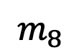
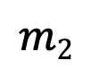
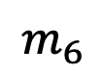
Merkle tree (Merkle 1989)
commitment
$$h$$
Goal:
commit to list S of size n
Later prove $S[i]=m_{i}$
Merkle tree commitment
$$m1$$
$$m2$$
$$m3$$
$$m_{4}$$
$$m_{5}$$
$$m_{6}$$
$$m_{7}$$
$$m_{8}$$
list of values S

Slide 26
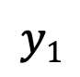
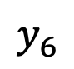
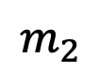
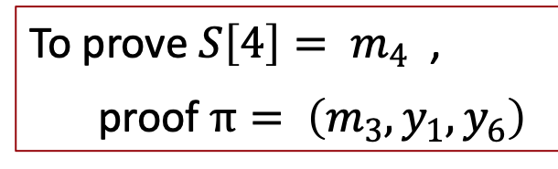
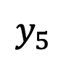
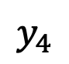
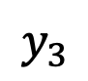

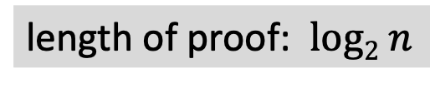
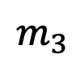
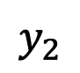
Merkle tree (Merkle 1989)
commitment
$$h$$
Goal:
commit to list S of size n
Later prove $S[i]=m_{i}$
$$y_{5}$$
H
$$y_{6}$$
H
H
$$y1$$
$$y_{2}$$
$$y_{3}$$
$$y_{4}$$
To prove ${S\left[4\right]= m}_{4}$ ,
proof $π= \left(m_{3}, y_{1}, y_{6}\right)$
H
H
H
H
$$m1$$
$$m_{2}$$
$$m_{3}$$
$$m_{4}$$
$$m_{5}$$
$$m_{6}$$
$$m_{7}$$
$$m_{8}$$
length of proof: $log2 n$
list of values S

Slide 27
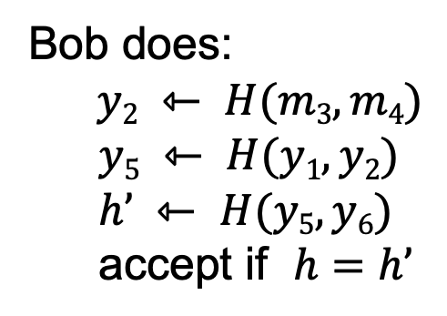
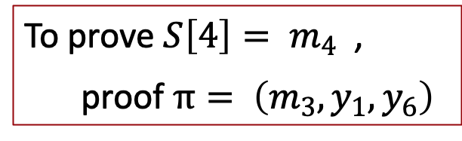
Merkle tree (Merkle 1989)
commitment
$$h$$
To prove ${S\left[4\right]= m}_{4}$ ,
proof $π= \left(m_{3}, y_{1}, y_{6}\right)$
$$y_{5}$$
H
$$y_{6}$$
H
H
Bob does:
$y2 ⇽ H(m3,m4)$
$$y5 ⇽ H(y1, y2)$$
$$h’ ⇽ H(y5, y6)$$
accept if $h=h’$
$$y1$$
$$y_{2}$$
$$y_{3}$$
$$y_{4}$$
H
H
H
H
$$m1$$
$$m_{2}$$
$$m_{3}$$
$$m_{4}$$
$$m_{5}$$
$$m_{6}$$
$$m_{7}$$
$$m_{8}$$
list of values S

Slide 28
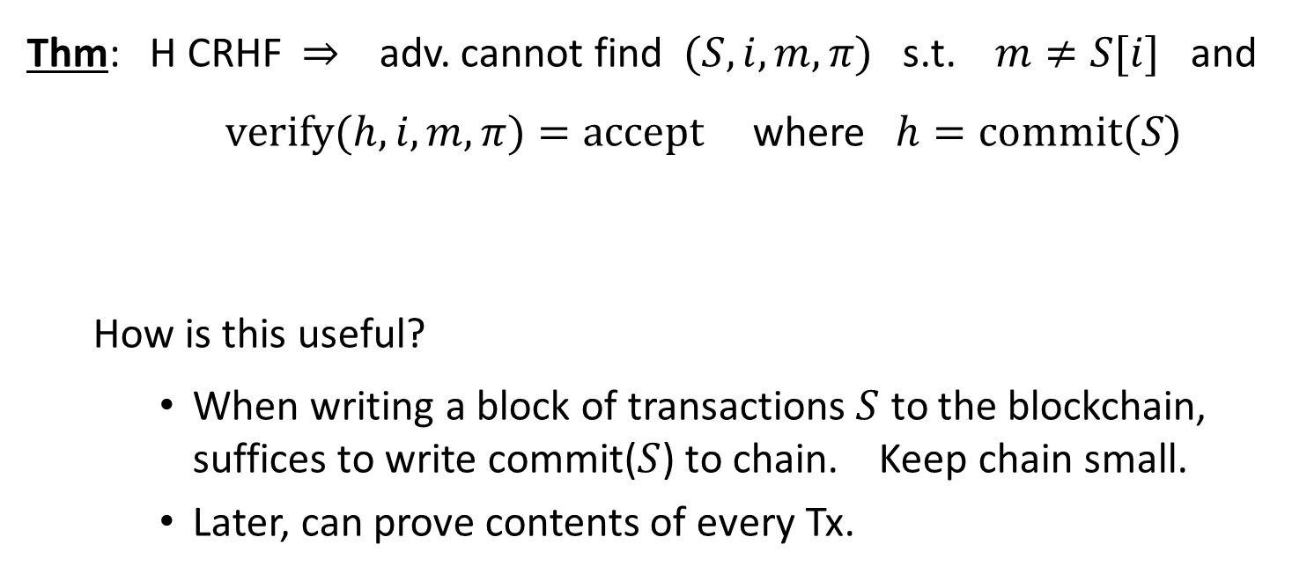
Merkle tree (Merkle 1989)
Thm: H CRHF ⇒ adv. cannot find $(S, i, m, π)$s.t. $m≠S[i]$ and $verify(h,i,m,π)=accept$where $h=commit(S)$
How is this useful?
When writing a block of transactions $S$ to the blockchain, suffices to write commit($S$) to chain. Keep chain small.
Later, can prove contents of every Tx.
Super useful. Example

Slide 29
Abstract block chain
blockchain
block header
block header
block header
⊥
Merkle root
other data
hash
Merkle root
other data
hash
Merkle root
other data
Merkle tree
Merkle tree
Merkle tree
Tx₁ Tx₂ … Tx_{n}
Tx₁ Tx₂ … Tx_{n}
Tx₁ Tx₂ … Tx_{n}
Merkle proofs are used to prove that a Tx is “on the block chain”

Slide 30
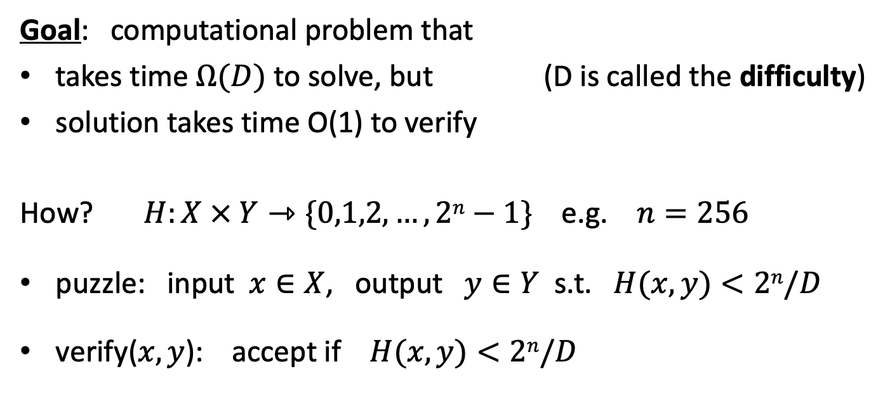
Another application: proof of work
Goal: computational problem that
takes time $Ω(D)$ to solve, but (D is called the difficulty)
solution takes time O(1) to verify
How? $H:X × Y⇾\{0,1,2,…,2n−1\}$ e.g. $n=256$
puzzle: input $x∈X$, output $y∈Y$ s.t. $H(x,y)<2n/D$
verify($x,y$): accept if $H(x,y)<2n/D$

Slide 31
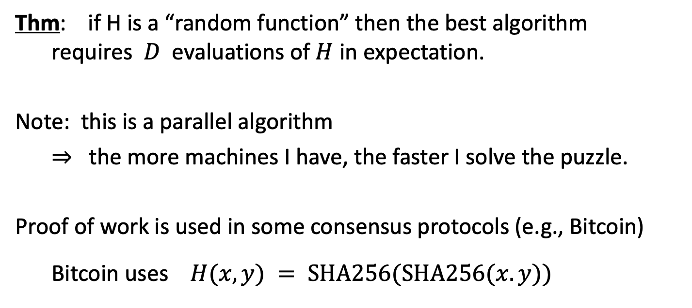
Another application: proof of work
Thm: if H is a “random function” then the best algorithm requires $D$ evaluations of $H$ in expectation.
Note: this is a parallel algorithm
⇒ the more machines I have, the faster I solve the puzzle.
Proof of work is used in some consensus protocols (e.g., Bitcoin)
Bitcoin uses $H(x,y) = SHA256(SHA256(x.y))$

Slide 32
Cryptography background: Digital Signatures
How to authorize a transaction

Slide 33
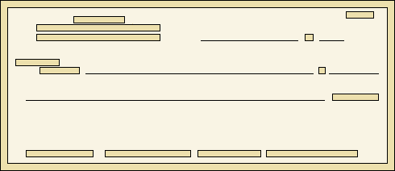
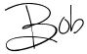
Signatures
Physical signatures: bind transaction to author
Bob agrees to pay Alice 1$
Bob agrees to pay Alice 100$
Problem in the digital world:
anyone can copy Bob’s signature from one doc to another
Notes:
Bad example: will see why on the last slide of this segment.

Slide 34
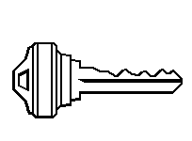
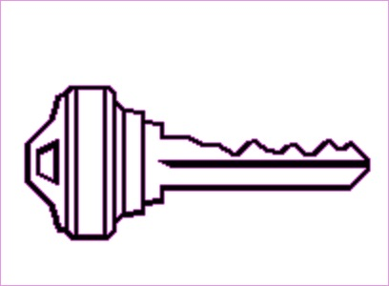
Digital signatures
Solution: make signature depend on document
Signer
Verifier
‘accept’
or
‘reject’
Bob agrees to pay Alice 1$
verifier
signature
signing
algorithm
secret signing key (sk)
public verification key (pk)

Slide 35
Digital signatures: syntax
Def: a signature scheme is a triple of algorithms:
Gen(): outputs a key pair (pk, sk)
Sign(sk, msg) outputs sig. σ
Verify(pk, msg, σ) outputs ‘accept’ or ‘reject’
Secure signatures: (informal)
Adversary who sees signatures on many messages of his choice, cannot forge a signature on a new message.

Slide 36
Families of signature schemes
RSA signatures (old … not used in blockchains):
long sigs and public keys (≥256 bytes), fast to verify
Discrete-log signatures: Schnorr and ECDSA
short sigs (48 or 64 bytes) and public key (32 bytes)
BLS signatures: 48 bytes, aggregatable, easy threshold
Post-quantum signatures: long (≥768 bytes)
(Bitcoin, Ethereum)
(Ethereum 2.0, Chia, Dfinity)
Notes:
Quantum computers will compromise security since they can solve NP-hard (exponential) problems that has large search space; so it will require much longer signatures; as can be seen above, from 48 to 64 bytes standard security to >768 bytes for quantum security!
Quantum computers mostly good at parallelism, not much advantage in calculation speeds such as hashing versus standard computer architecture.

Slide 37
Signatures on the blockchain
Signatures are used everywhere:
ensure Tx authorization,
governance votes,
consensus protocol votes.
verifyTx
verifyTx
verify Tx
sk₁
data
signatures
sk₂
data
signatures
Notes:
One issue with blockchain technology is Double Spending; if consensus is not reached fast enough (so that all forks quickly merge into one chain) to keep one chain; if there are several forks that do not merge, then there are two “timelines” where the same money can be spent (double spent).

Slide 38
Bitcoin mechanics
user facing tools (cloud servers)
applications (DAPPs, smart contracts)
compute layer (blockchain computer)
consensus layer

Slide 39
First: overview of the Bitcoin consensus layer
Bitcoin P2P network
end users
signed Tx
sk_{A}
sk_{B}
sk_{C}
typically, miners are connected to eight other peers (anyone can join)

Slide 40
First: overview of the Bitcoin consensus layer
mempool
miners broadcast received Tx to the P2P network
every miner:
validates received Tx and
stores them in its mempool
(unconfirmed Tx)
note: miners see all Tx before they are posted on chain
Bitcoin P2P network
Notes:
Miners may decide to front run a Tx, if it is profitable.
*note: miners have control which transactions to include (for verification) or not

Slide 41
First: overview of the Bitcoin consensus layer
blockchain
I am the leader
Every 10 minutes:
Each miner creates a candidate block from Tx in its mempool
a “random” miner is selected, and broadcasts its block to P2P network
all miners validate new block
Bitcoin P2P network
Notes:
Tx in new block are removed from the mempool.

Slide 42
First: overview of the Bitcoin consensus layer
blockchain
6.25 BTC
Selected miner is paid 6.25 BTC in coinbase Tx (first Tx in the block)
only way new BTC is created
block reward halves every four years
⇒ max 21M BTC
note: miner chooses order of Tx in block
Notes:
Miners want to be selected as often as possible: can join multiple times to increase their chances. Need to prevent that.

Slide 43
Properties (very informal)
Persistence:
to remove a block, need to convince 51% of mining power *
Liveness:
to block a Tx from being posted, need to convince 51% of mining power **
(some sub 50% censorship attacks, such as feather forks)

Slide 44
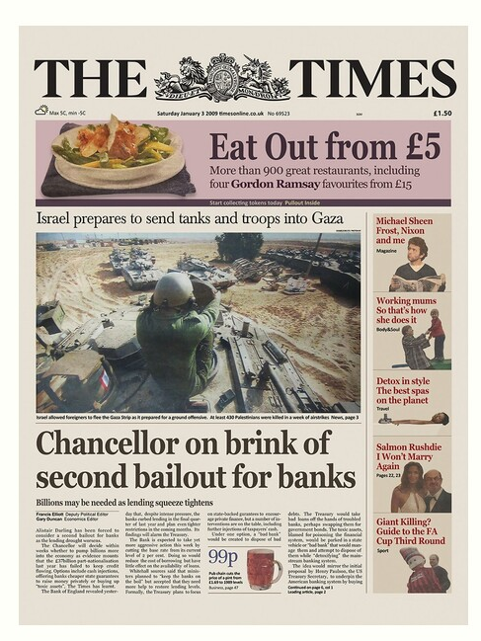
Bitcoin blockchain: a sequence of block headers, 80 bytes each
genesis block
BH₃
BH₁
BH₂
version (4 bytes)
prev (32 bytes)
time (4 bytes)
bits (4 bytes)
nonce (4 bytes)
Tx root (32 bytes)
prev
Tx root
prev
Tx root
H
H
H
…
80 bytes
coinbase Tx
coinbase Tx

Slide 45
Bitcoin blockchain: a sequence of block headers, 80 bytes each
time: time miner assembled the block. Self reported. (block rejected if too far in past or future)
bits: proof of work difficulty
nonce: proof of work solution
Merkle tree: payer can give a short proof that Tx is in the block
new block every ≈10 minutes.
for choosing a leader (next week)

Slide 46
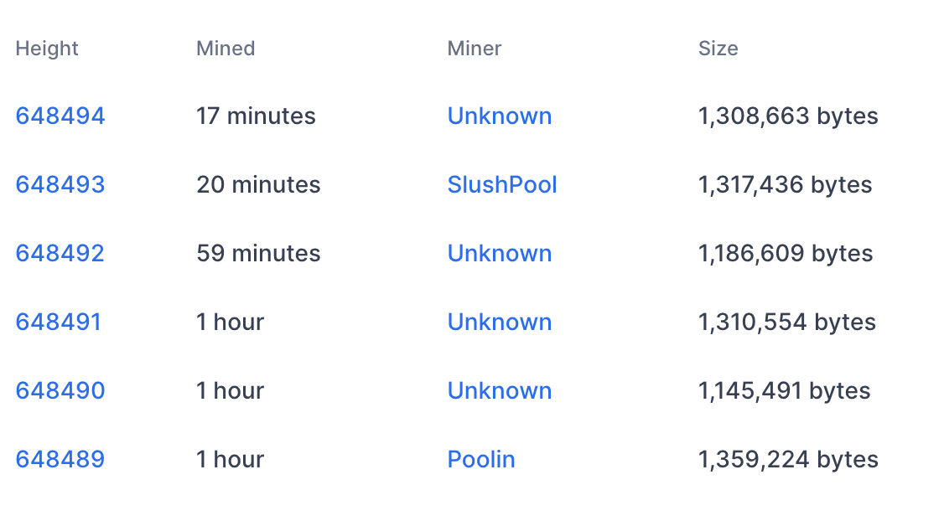
An example (Sep. 2020)
Tx data
#Tx
1855
2826
1128
2774
2075
2622

Slide 47
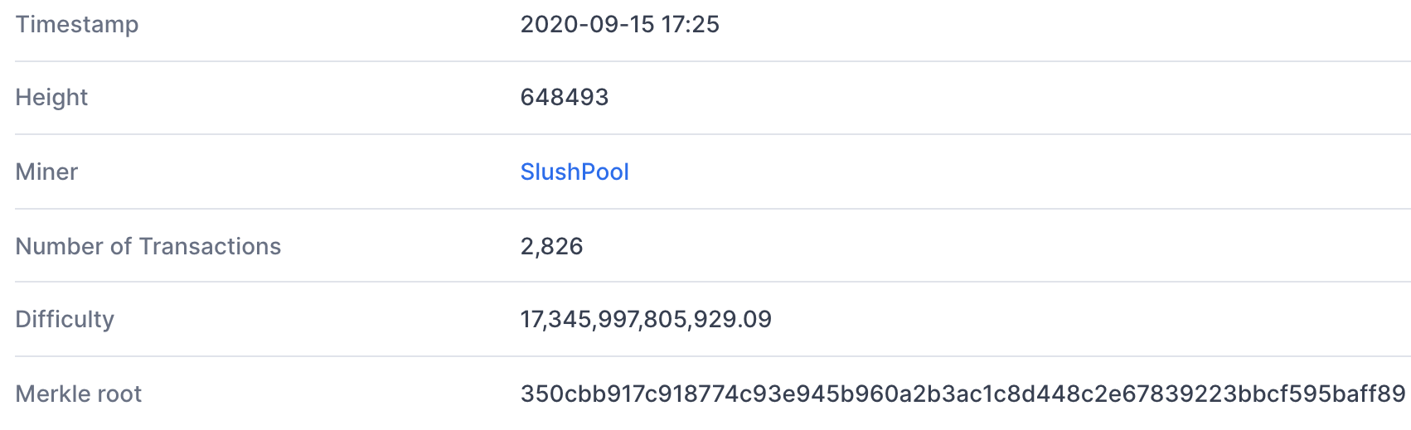
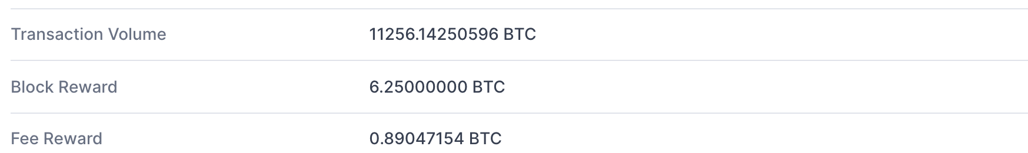
Block 648493
(from coinbase Tx)
(D)
(adjusts every two weeks)
(Tx fees given to miner in coinbase Tx)

Slide 48
Bitcoin Blockchain
View the blockchain as a sequence of Tx (append-only)
…
coinbase Tx

Slide 49
Tx structure (non-coinbase)
input[0]
input[1]
input[2]
output[0]
output[1]
witnesses (part of input)
locktime
TxID
out-index
ScriptSig
seq
32 byte hash
input:
inputs
4 byte index
program
TxID = H(Tx)
ignore
outputs
(excluding witnesses)
output:
value
ScriptPK
8 bytes
(segwit)
program
(4 bytes)
#BTC = value/10⁸
earliest block # that can include Tx
Notes:
10⁻⁸ BTC = 1 Satoshi ~ 0.01 cent
TxID are unique – two Tx cannot have the same TxID, because inputs are unique. The only exception is the coinbase Tx, which has no inputs, so that two coinbase Tx can have the same TxID. To solve that, every coinbase Tx includes the block height in its ScriptPk (BIP 34).

Slide 50
Example
null locktime
TxIn[0]
TxOut[0]
TxOut[1]
Tx1:
input
2
ScriptPK
5
ScriptPK
0
(funding Tx)
value
value
UTXO₁
UTXO₂
UTXO: unspent Tx output
TxIn[0]
TxOut[0]
TxOut[1]
Tx2:
TxID
1
ScriptSig
output
output
0
(spending Tx)
identifies a UTXO
UTXO₃
UTXO₄
Notes:
ScriptPK specifies who or how can spend.
Bitcoin employs the above method: summary is that coins are tracked and can be combined or split; i.e. 2 + 4 +4 bitcoins can be combined into 1 bitcoin worth 10.
UTXO = a large bitcoin is used but only a portion of it; it needs to be split and the remaining sent back to owner.

Slide 51
Example
☓
null locktime
TxIn[0]
TxOut[0]
TxOut[1]
Tx1:
input
2
ScriptPK
5
ScriptPK
0
(funding Tx)
UTXO₁
UTXO₂
UTXO: unspent Tx output
TxIn[0]
TxOut[0]
TxOut[1]
Tx2:
TxID
1
ScriptSig
output
output
0
(spending Tx)
identifies a UTXO
UTXO₃
UTXO₄

Slide 52
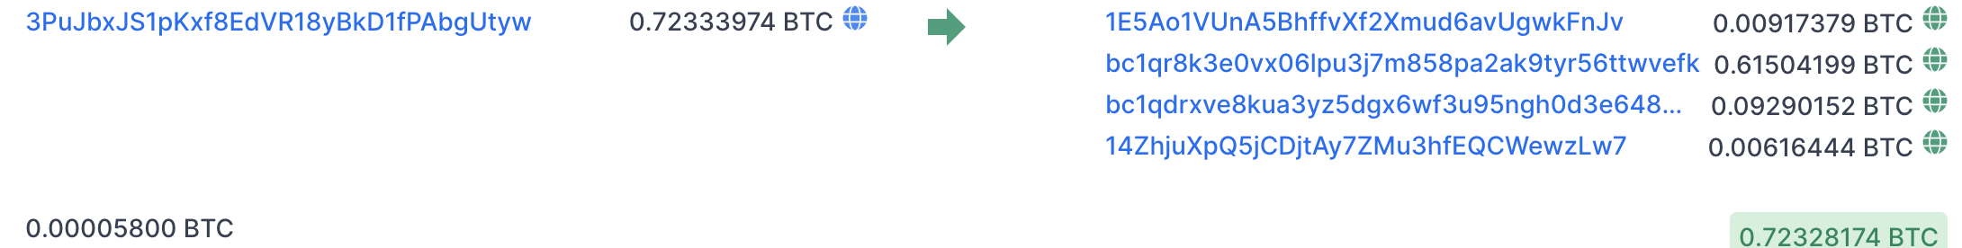
An example (block 648493) [2826 Tx]
Tx0
6.25 + Tx fees =
input
(input UTXO value)
Tx1
outputs
(Tx fee)
Tx2
(Tx fee)
sum of fees in block added to coinbase Tx
Notes:
Fees: Tx1 0.00005 BTC ≈ .5$,
Fees: Tx2 0.002 BTC ≈ 20$.
Low Tx fee in Tx means Tx will remain unconfirmed (sit in mempool).
To frontrun a Tx: submit a Tx with a higher Tx fee.

Slide 53
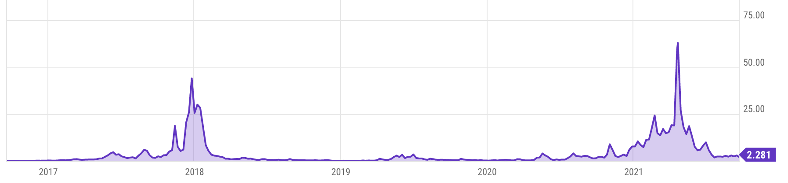
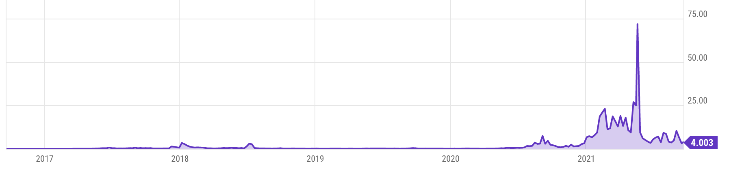
Tx fees
Bitcoin average Tx fees in USD
Ethereum average Tx fees in USD
Notes:
Fee depends on network congestion, price of BTC.

Slide 54
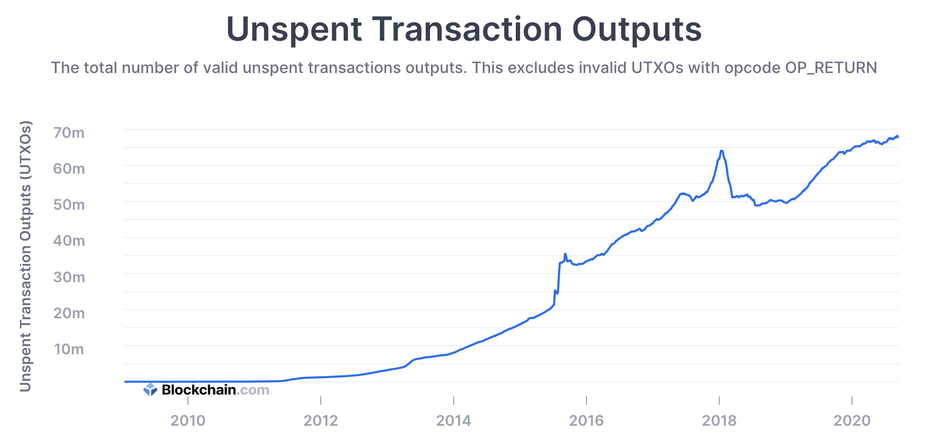
All value in Bitcoin is held in UTXOs
Sep. 2021: miners need to store ≈76M UTXOs in memory
Notes:
How many Bitcoins do I have: need to find all the UTXOs on chain that I can spend. Typically done by wallet software (next lecture).

Slide 55
Cryptocurrency Risks
User Risk: no way to reverse or cancel a transaction
Regulatory Risk: are they securities or currencies?
Counterparty Risk: Many investors rely on exchanges or other custodians to store their cryptocurrency (centralized wallets; like a bank, except it is just a place where you exchange only not save money).
Management Risk
Programming Risk
Manipulation Risk
Notes:
Cryptocurrency largely unregulated – but that was the original purpose.

Slide 56
Binance Security Breach
https://binance.zendesk.com/hc/en-us/articles/360028031711-Binance-Security-Breach-Update
The hackers were able to withdraw 7000 BTC in this one transaction
Notes:
Binance is the biggest virtual currency exchange platform.

Slide 57

Bitfinex Hacking (2016)

Slide 58

OneCoin Scam

Slide 59

The Fall of Terra (May 2022)

Slide 60

FTX Collapse (November 2022)

